Slide 1

Revolutionizing Voting: The Online Voting System

Slide 2

Contents
1. The Need for Modernization
2. The Technology Behind Online Voting
3. Ensuring Trust and Transparency
4. Future of Democratic Participation

Slide 3

Section 1: The Need for Modernization
Revolutionizing Voting: The Online Voting System

Slide 4
Legal and Regulatory Considerations
01
In-Person Limitations
Traditional voting methods require physical presence, limiting accessibility for voters with mobility issues or those living in remote areas.
02
Time Constraints
Voters face time constraints, often leading to long queues and potential disenfranchisement.
03
Error-Prone Responses
Manual counting and recording of votes are susceptible to human errors and misinterpretation.

Slide 5
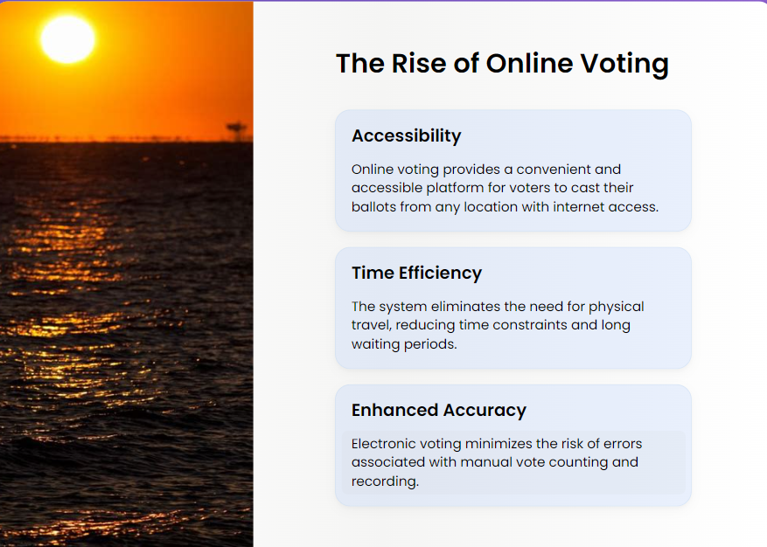
The Rise of Online Voting
Accessibility
Online voting provides a convenient and accessible platform for voters to cast their ballots from any location with internet access.
Time Efficiency
The system eliminates the need for physical travel, reducing time constraints and long waiting periods.
Enhanced Accuracy
Electronic voting minimizes the risk of errors associated with manual vote counting and recording.

Slide 6
Section 2: The Technology Behind Online Voting
Section 2: The Technology Behind Online Voting
Revolutionizing Voting: The Online Voting System
Revolutionizing Voting: The Online Voting System

Slide 7
Secure Authentication
01
Multi-Factor Authentication
Implementing robust authentication methods to verify the identity of voters and prevent unauthorized access.
02
Encryption protocols
Utilizing advanced encryption techniques to secure voter data and maintain the confidentiality of ballots.
03
Bio-metric Verification
Exploring biometric authentication as an additional layer of security to prevent identity fraud.

Slide 8
Section 3: Ensuring Trust and Transparency
Revolutionizing Voting: The Online Voting System

Slide 9
Audit Trail and Verification
01
Transparent
Records
Providing voters with the ability to verify their votes and ensuring the transparency of the entire voting process.
02
Immutable Records
Creating an immutable audit trail of votes to enable independent verification and auditing of the election results.
03
Public Verification
Allowing independent organizations and individuals to verify the integrity of the voting process through publicly accessible records.

Slide 10
Voter Education and Management
01
Educational
Campaigns
Conducting voter education campaigns to familiarize voters with the online voting process, security measures, and the importance of participation.
02
Interactive Tutorials
Providing interactive tutorials and resources to guide voters through the online voting platform and address common concerns.
03
Community Engagement
Engaging with local communities to address any skepticism or misconceptions about online voting through open forums and information sessions.

Slide 11
Section 4: Future of Democratic Participation
Revolutionizing Voting: The Online Voting System

Slide 12
Global Adoption
01
International
Expansion
Exploring opportunities for the global adoption of online voting systems to facilitate democratic participation across borders.
02
Cross-Border Elections
Enabling cross-border voting for citizens residing abroad, expatriates, and international organizations to participate in elections.
03
Diplomatic Collaboration
Collaborating with international entities and diplomatic missions to implement secure and accessible online voting solutions.

Slide 13
Inclusive Democracy
01
Youth Management
Encouraging youth participation in the democratic process through user-friendly and digitally accessible voting platforms.
02
Accessibility Advocacy
Advocating for the rights of individuals with disabilities and elderly voters by providing inclusive and accessible voting solutions.
03
Remote Voting
Facilitating voting for individuals in remote or rural areas, ensuring their voices are heard in the democratic process.

Slide 14

PERSONA
Persona Name: Karthik
Background:
Age: 20
Occupation: Student
Education: B .Tech 3rd Year
Location: Urban area
Experience with Online Voting: Intermediate
Goals:
Ensure secure and accurate voting.
Save time and avoid lines.
Stay informed about candidates.
Challenges:
Security concerns.
Limited access to reliable information.
Difficulty with registration.
Needs:
Accessible and user-friendly platform.
Trustworthy political information.
Clear registration instructions.
Motivations:
Desire for community impact.
Convenience of remote voting.
Confidence in influencing election outcomes.

Slide 15

CUSTOMER JOURNEY MAP
Awareness: Users discover online voting options through social media, news articles, or official election communications.
Research: Users explore online voting systems, learning about features, security measures, and eligibility requirements.
Registration: Users register for online voting, providing personal information and verifying identity securely.
Voting: On election day, users log in to the online platform, casting electronic ballots for preferred candidates or issues.
Confirmation: After voting, users receive confirmation messages verifying their vote has been recorded and counted.
Feedback: Users provide feedback, sharing concerns or suggestions to improve the voting experience.

Slide 16

CONCLUSION
Finally, the implementation of online voting management systems represents a significant step forward in modernizing our democratic processes. So, online voting has the potential to increase voter turnout and promote a more inclusive and democratic society.

Slide 17

THANK YOU

